Slide 1
DTSA 5509 Supervised Learning Project
Predicting Redo Ablation Risk: A Supervised Learning-Based Clinical Scoring System

Slide 2
Objectives
Predict the redo ablation outcome
Create a clinical scoring tool to predict risk of redo ablation

Slide 3
Data Description
https://physionet.org/content/shdb-af/1.0.1/
Years 2019 and 2023
128 ECG records (24 hours)
ECGs are stored in WFDB format
Patient data was anonymized per HIPAA, with random 3-digit ID
Various demographic data obtained

Slide 4
Pre-Processing
ECG Extraction
Loaded the ECG and attached it to the dataset per patient ID
Detect R to R peaks
Obtain heart rate variability
Obtain entropy values
Then append to the final dataset
Evaluate for missing data
Dropped columns with 100% missing
Some columns were missing because 1 = yes, and 0 = no, impute 0
For less % missing, impute mean for continuous variables
For columns with multiple categorigal values
Used one-hot encoding

Slide 5
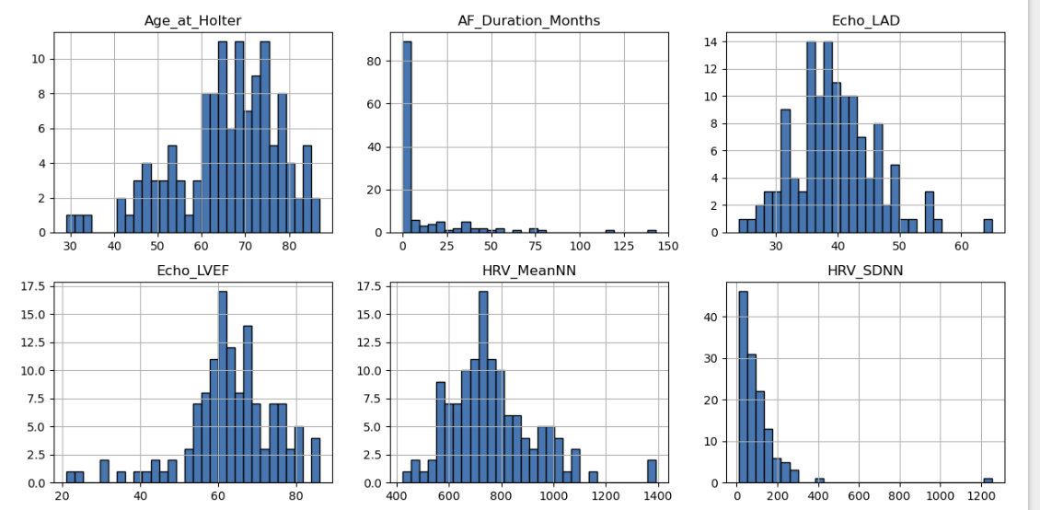
Exploratory Data Analysis
Age
AF duration
LAD
LVEF
HRV

Slide 6
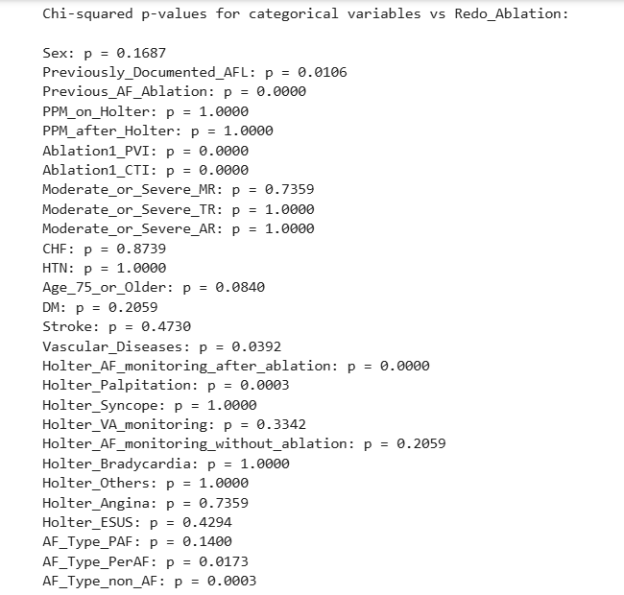
Exploratory Data Analysis
Significant with Redo
PVI
CTI
Vasc dx
Holter after ablation for AF
Holter for palpitation
AF non AF type

Slide 7
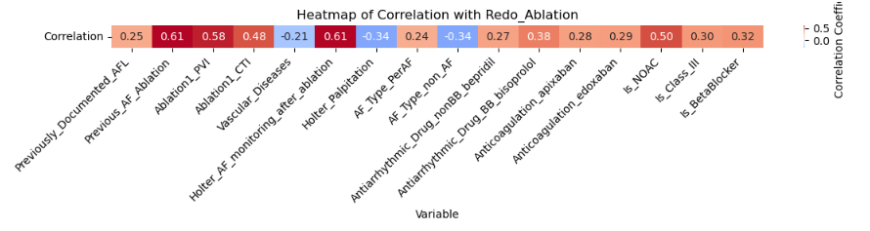
EDA: Biserial Correlation
Previous ablation
PVI
CTI
AF monitoring
NOAC

Slide 8
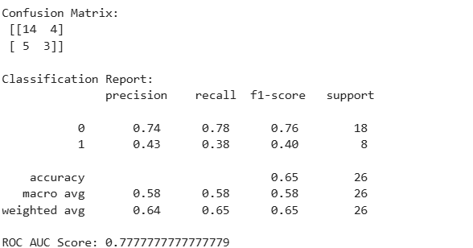
Machine Learning: LR
Acc: 0.65
ROC AUC: 0.78
Some miscalculation
Struggles with class 1
Decent performance

Slide 9
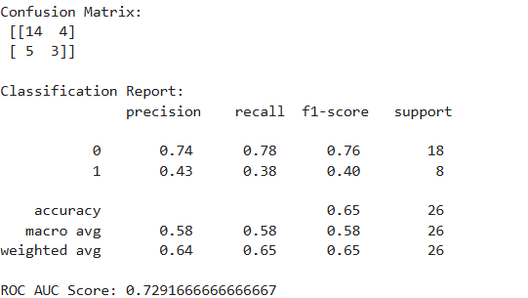
Machine Learning: LR with SMOTE
ROC AUC 0.73
Slight improvement in class 1
Minor decline in discriminative ability (decreased AUC)
Marginal gains

Slide 10
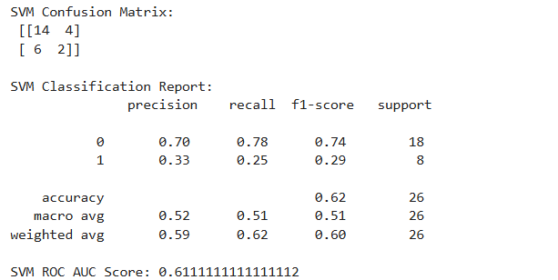
Machine Learning: SVM
Acc decrease 0.62
Slightly worse class 0
Sig decrease in class 1: 0.42 to 0.25
This model underperforms

Slide 11
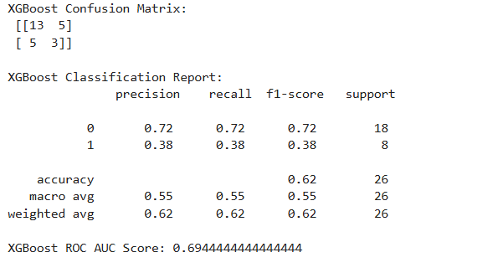
Machine Learning: XGBoost
Acc 0.62
Improved class 0 over SVM
Improved class 1 over SVM
AUC 0.69
Better than SVM but not as good as LR

Slide 12
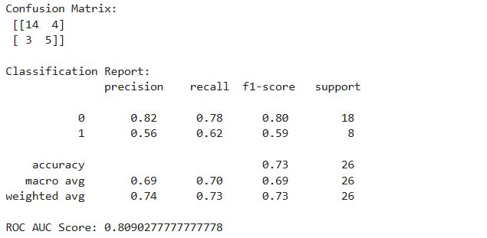
Machine Learning: RF with SMOTE
Fewer false negatives
Acc 0.81
Class 0: 0.82
Class 1: 0.62
Outperforms the others in accuracy, balance, and discriminative ability.

Slide 13
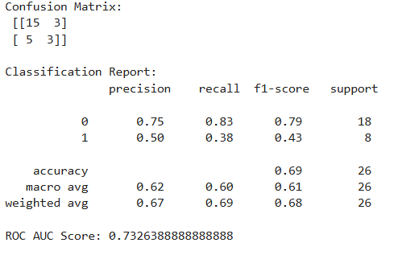
Machine Learning: RF Select Forward
Slightly more false positives
Slightly improved class 0
Slightly worse class 1
Acc 0.73
Underperforms the previous one, particularly in Class 1 recall and overall balance.

Slide 14
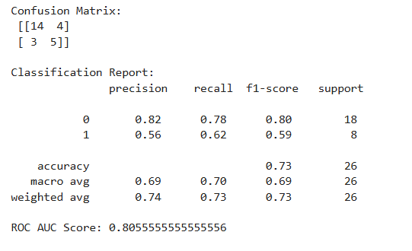
Machine Learning: RF Tuning Depth Split
Acc 0.73
AUC: 0.81
Recovers the higher accuracy and balance, with a better ROC AUC, making it one of the top performers

Slide 15
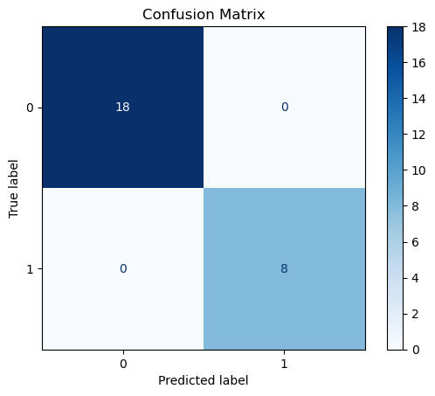
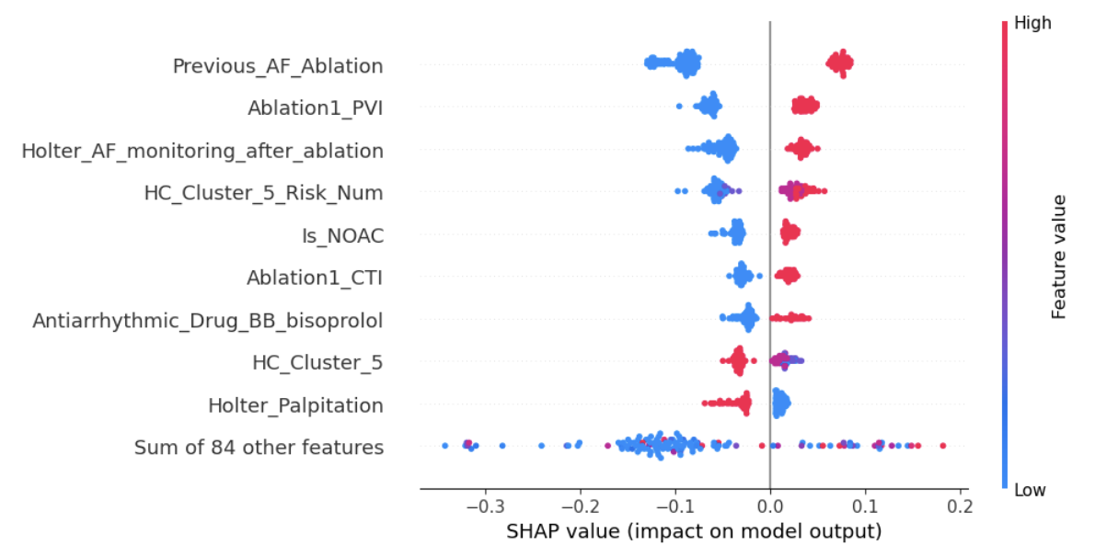
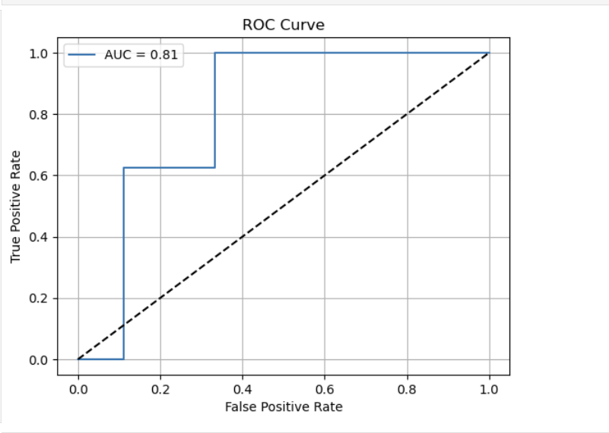
RF Tuned Validation

Slide 16
RF Tuned Cross Validation
Fold | Accuracy | Precision (Class 1) | Recall (Class 1) | F1-Score (Class 1) | ROC AUC
Fold 1 | 0.92 | 1.00 | 0.71 | 0.83 | 0.977
Fold 2 | 0.77 | 0.57 | 0.57 | 0.57 | 0.842
Fold 3 | 0.96 | 0.86 | 1.00 | 0.92 | 1.000
Fold 4 | 0.92 | 0.75 | 1.00 | 0.86 | 0.965
Fold 5 | 0.80 | 0.55 | 1.00 | 0.71 | 0.842
Mean | 0.87 | 0.74 | 0.86 | — | 0.93

Slide 17
Create a Scoring System to Predict the Risk of Red Ablation

Slide 18
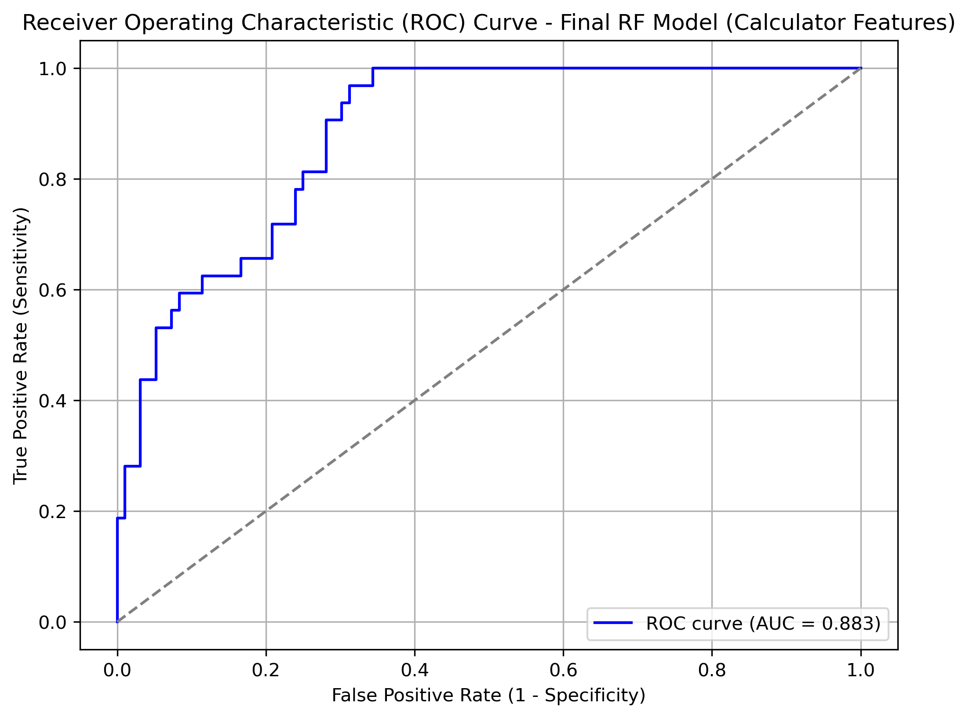
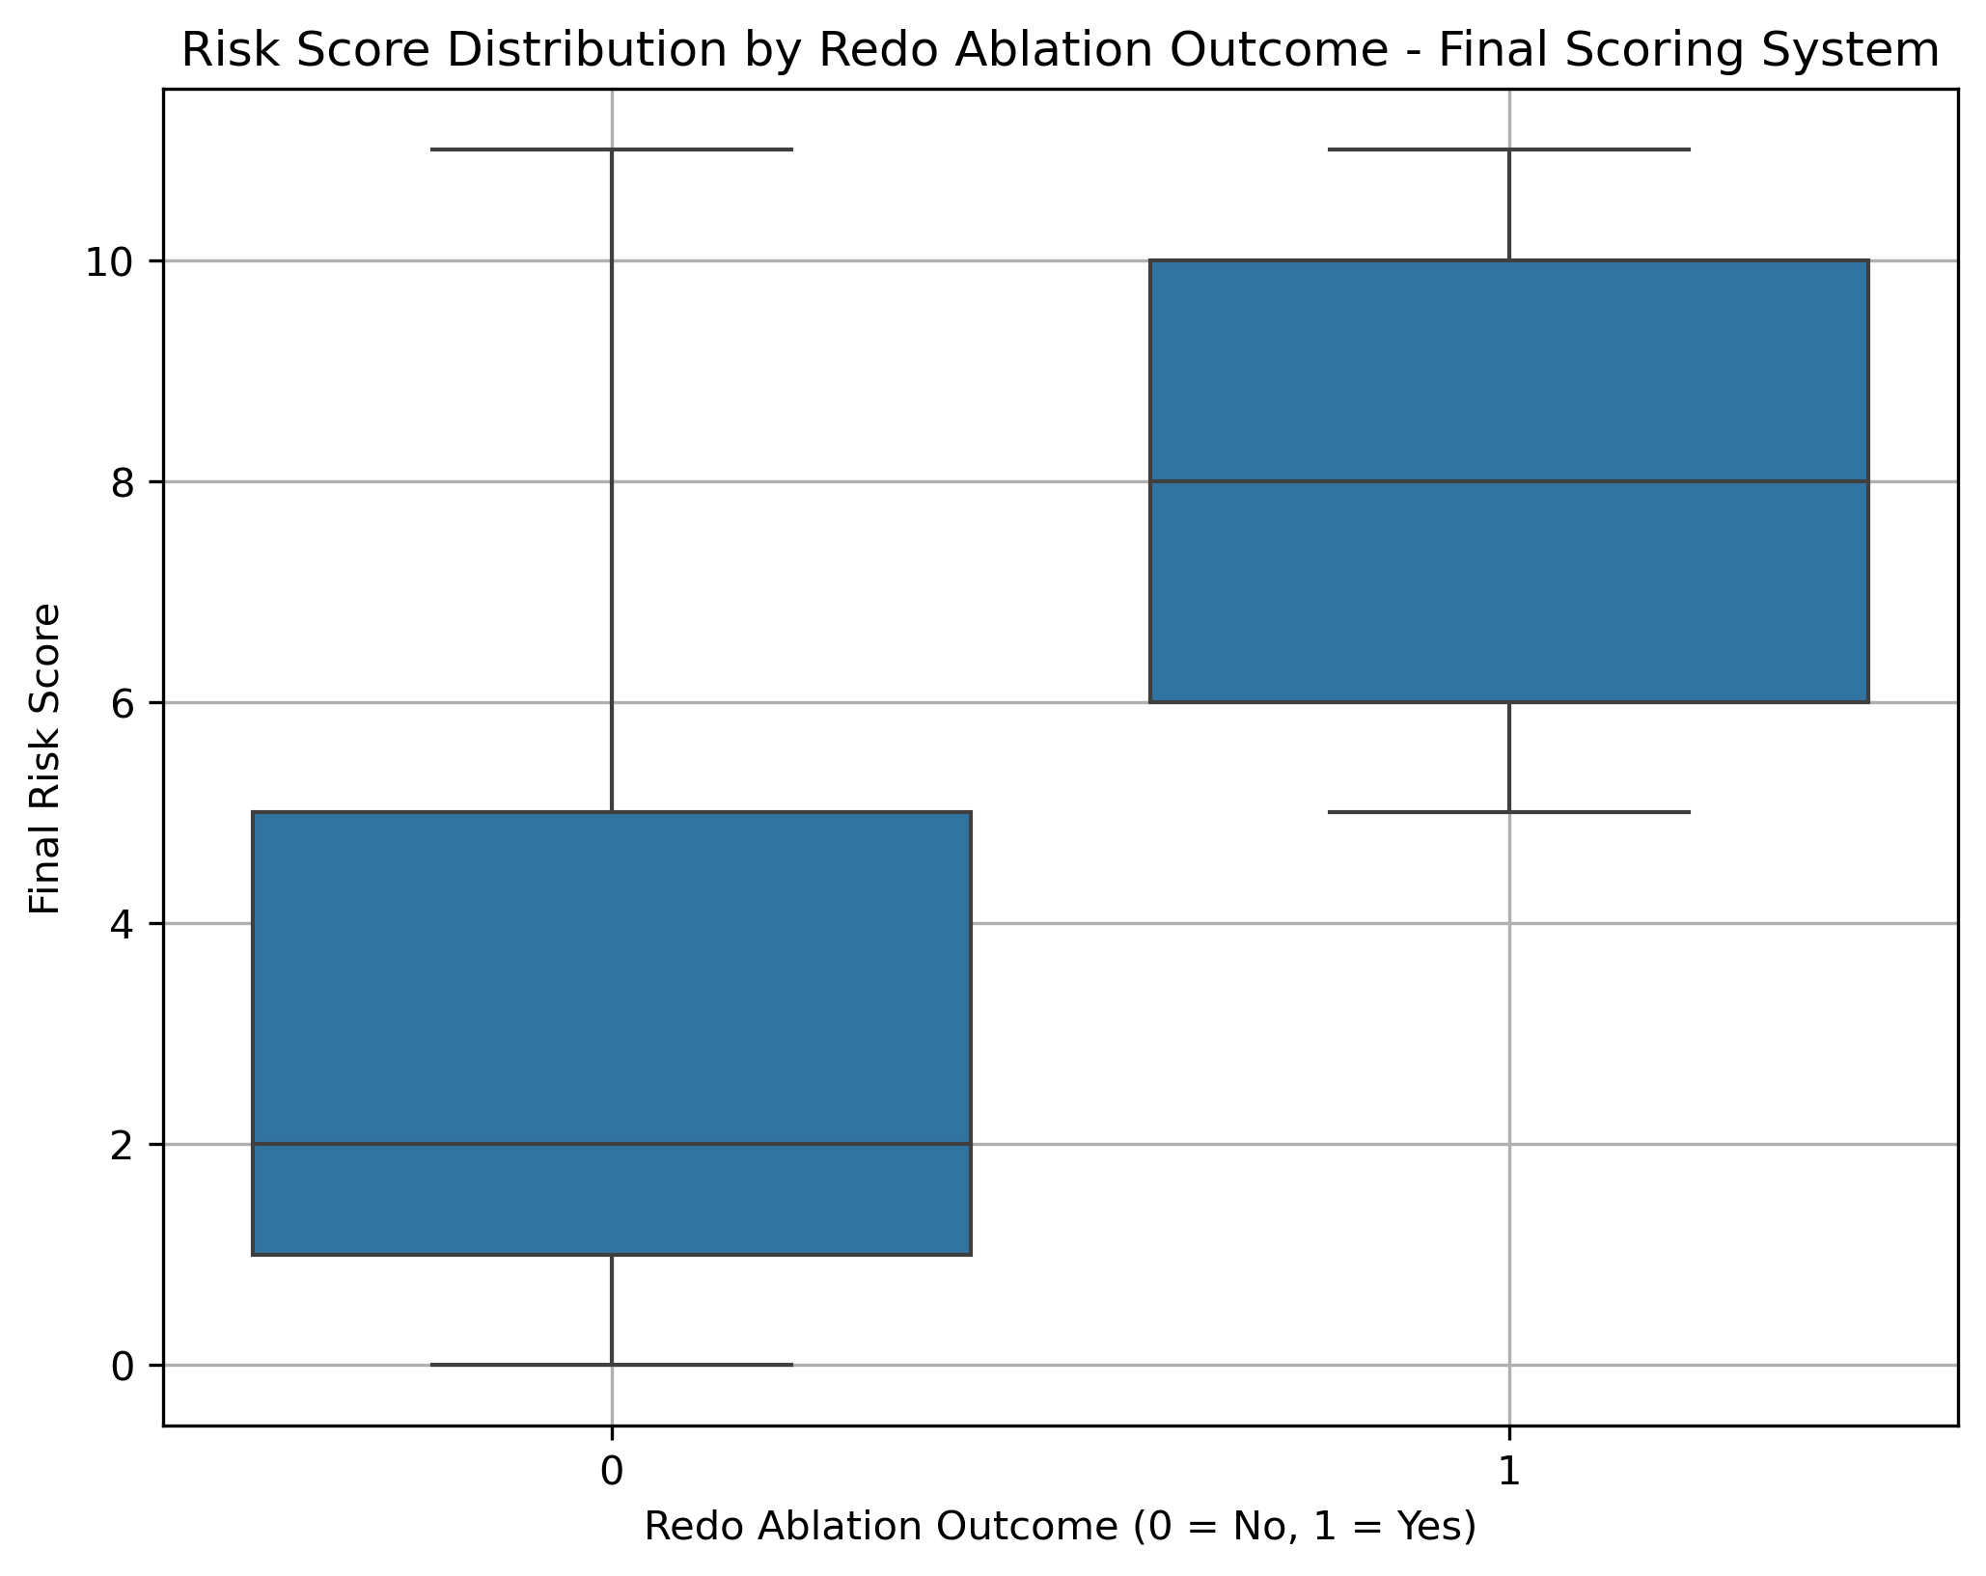
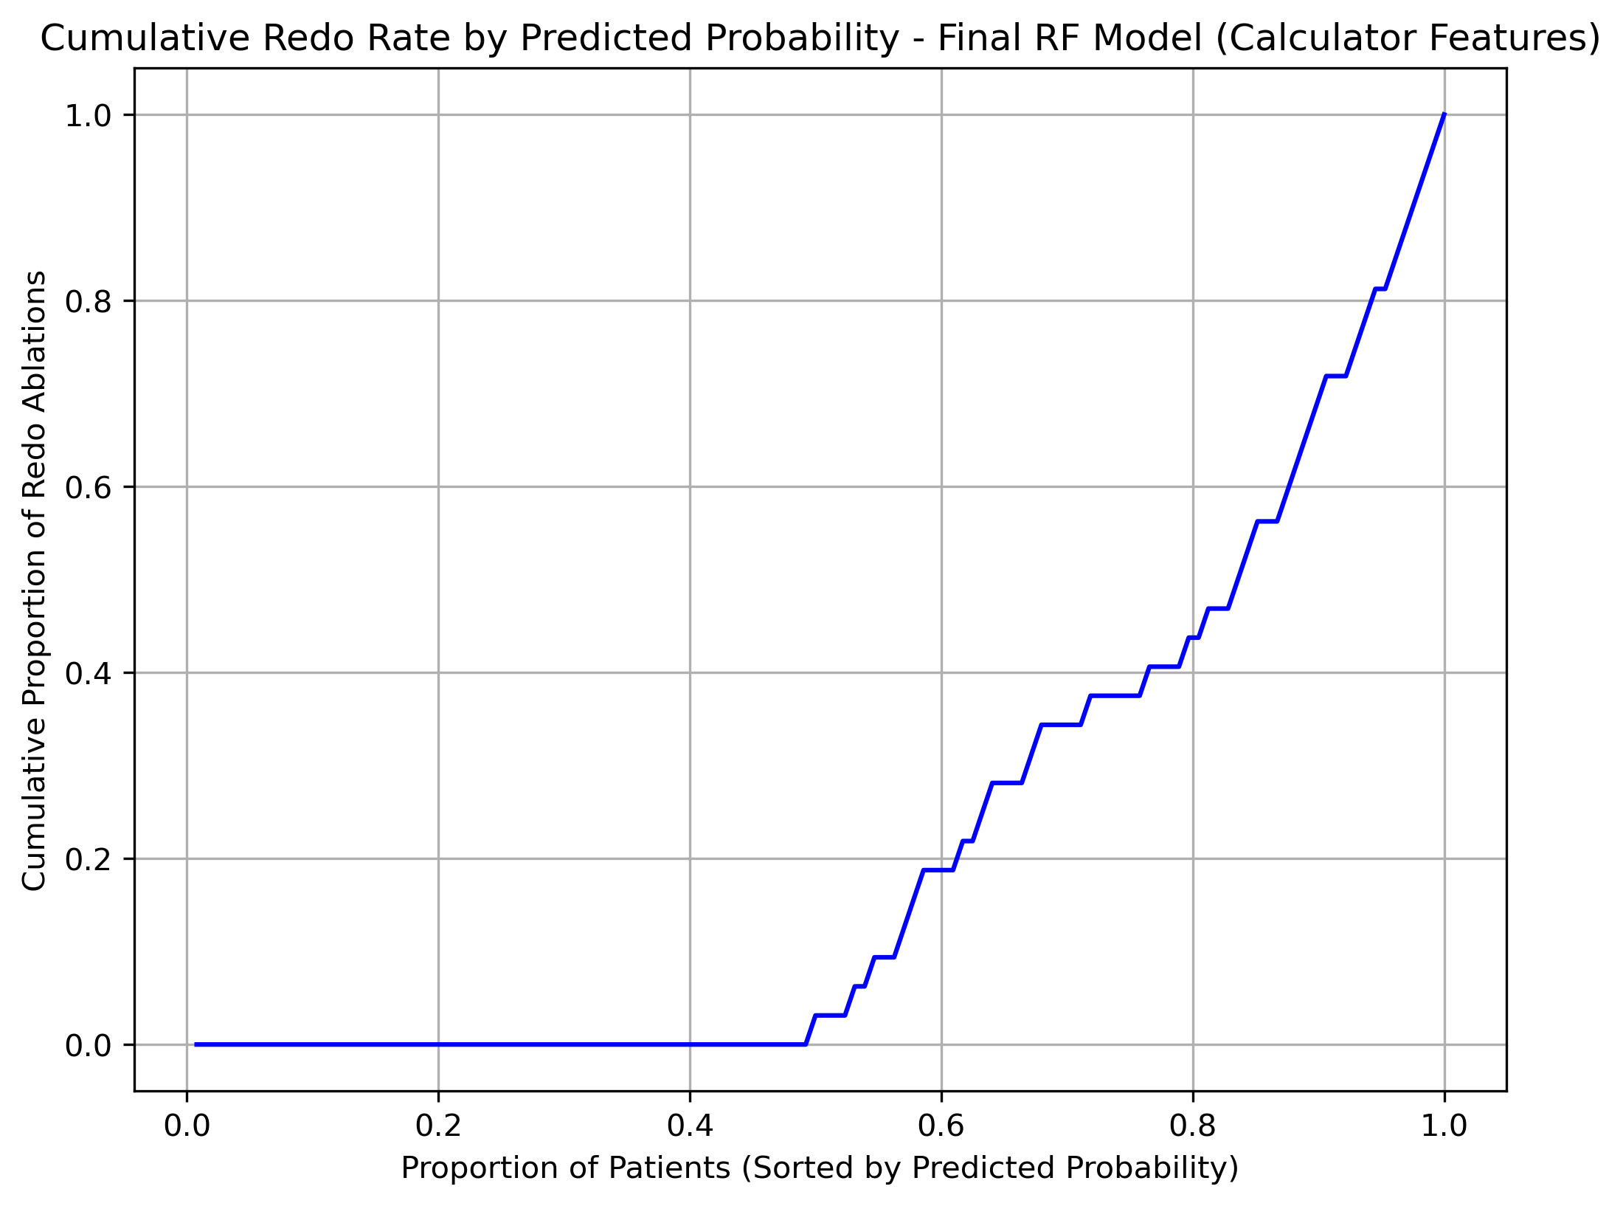
Clinical Scoring System

Slide 19
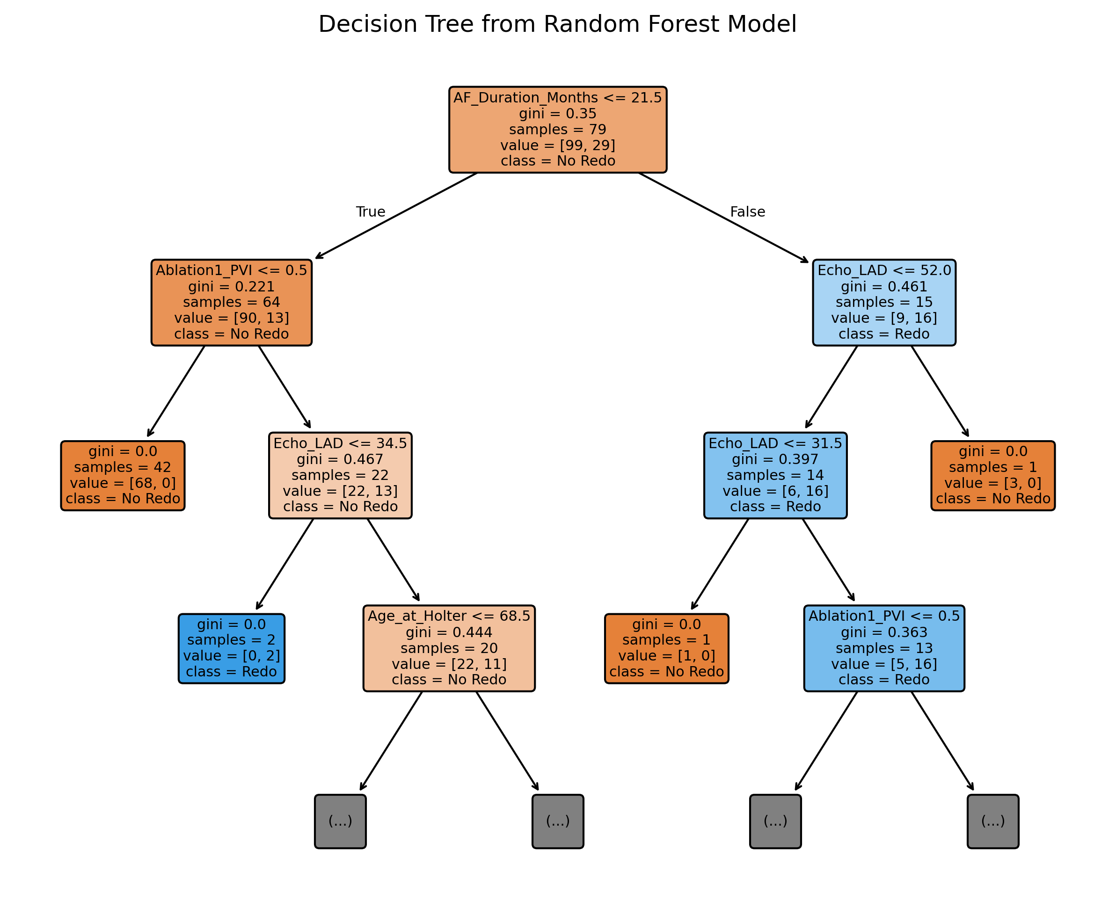

Slide 20
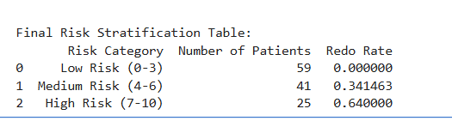
Clinical Scoring System

Slide 21
Summary
Predict Redo Ablation
PVI, CTI, Vasc dx, Holter after ablation for AF, Holter for palpitation, AF non-AF type
Develop a Scoring System to Predict Redo Ablations by Risk
Risk of Redo
Low 0% risk of redo
Moderate 35% risk of redo
High 64% risk of redo
Scoring system
Base +2
PVI +5
AF duration >= 1 yr +4
LAD >= 35 mm - 1
Age >= 70 years - 1
Github: https://github.com/Vorlon41/Master-of-Data-Science-CU-Boulder-Colorado/tree/main/Machine%20Learning/DTSA%205509%20Introduction%20to%20Machine%20Learning%20Supervised%20Learning/Final

